Slide 1
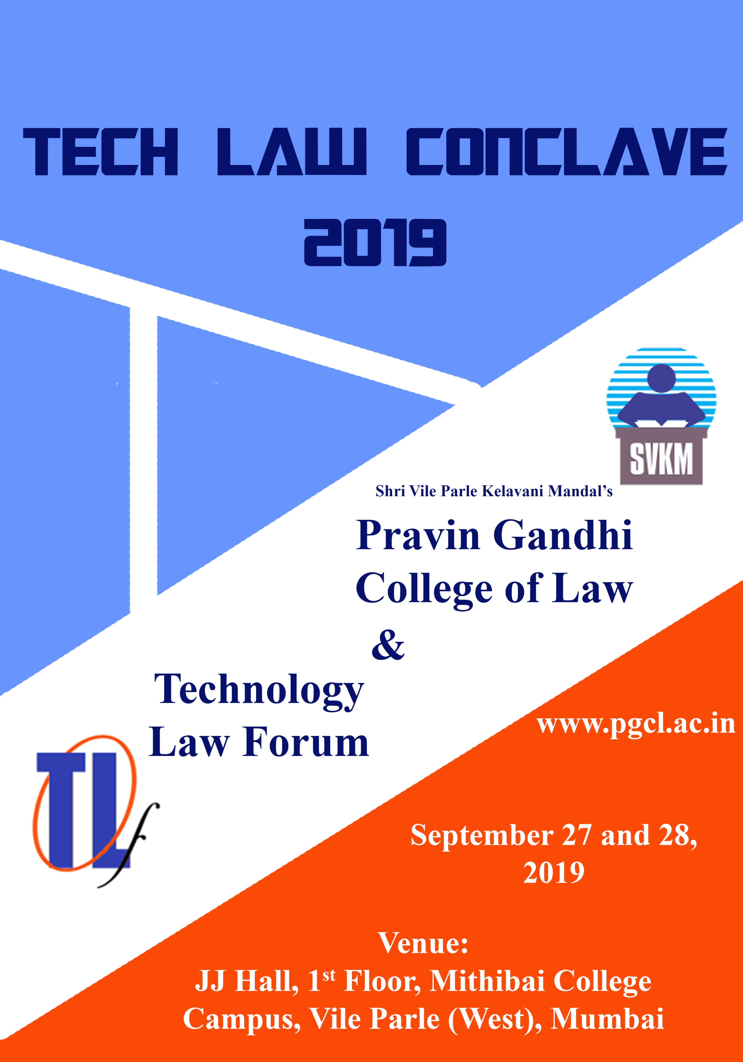

Slide 2
Pravin Gandhi College of Law
Pravin Gandhi College of Law is a Premier Law Institution under the aegis of Shri Vile Parle Kelavani Mandal. It is affiliated to the University of Mumbai and offers five year integrated Law Program B.L.S./LL.B.
In its endeavour of commitment to excellence, it seeks to provide an environment for interdisciplinary exchanges. It believes in blended learning model of practical and theory and strengthening industry academia relationship thereby giving students a platform to deliberate and discuss with the experts from the industry.
Organizing the ‘Technology Law Conclave 2019’ with ‘Technology Law Forum’ is one such initiative towards it’s vision of blended learning model leading to an enriched and holistic personality of its key stakeholders.
Technology Law Forum
Technology Law Forum is a Non-Profit making Organization for Demystifying Technology Law. It is multi-disciplinary and welcomes members from varied streams [Technologists, CTO/CIOs and their teams, Information Security Specialists, General Counsels, Lawyers, Law Makers, Law Enforcers, Regulators, Policy Makers, Judicial Officers, Business Executives, Entrepreneurs and Start-ups.]
It provides a platform for Technology-Law Discussions & Brainstorming on the emerging technology-law issues concerning every sector. ‘Tech Law Conclave 2019’ is one such initiative. It is the Brainchild of lawyers, general counsels and technologists with a passion for Technology Law.
Advisory Council for Tech Law Conclave 2019
Ms. N.S. Nappinai
Advocate, Supreme Court & Cyber Law Expert & A Founder Member of TLF
Mr. Subramaniam Vutha
Advocate & A Founder Member of TLF
Mr. Prashant Karkare
Director Legal and Special Projects, NCPA, Mumbai & A Founder Member of TLF
Mr. Sivaram Nair
Senior Joint Company Secretary, Larsen and Toubro Limited & A Founder Member of TLF
Mr. Tapan Pati
Director & Senior Legal Counsel, South Asia, Johnson & Johnson
Mr. Venkatesh Hariharan
Senior Fellow (Data Governance) IDFC Institute
Mr. Bharat Mehta
EVP, Regional General Counsel and Ethics & Compliance Officer – India & APAC, Capgemini & A Founder Member of TLF

Slide 3
Sponsors
Supporting
Organisations
Who Should Attend And Why?
If you are a | You will get Insights
Technologist | Into legal risks/issues and options re technology advances
CIO/Team Member | On legal implications of your decisions and actions
CTO/Team Member | On legal effects of technology advances
Information Security Specialist | To improve your ability to shape privacy and security systems
Law Firm/Lawyer/General Counsel | To equip you better to advise on legal implications of technology plans, options & risks; and on policies and transactions
Business Executive | To help you factor- in legal implications into technology plans
Entrepreneur/Start-Up | To help you avoid costly legal mistakes/loss of good options
Student/Academician | To understand the emerging issues in the field of Tech-Law
Judicial Officer | To make better informed decisions
Regulator/Public Official | To aid you in shaping and implementing regulations
REGISTRATION LINK
Registration Details
Professionals: Rs. 4000 | Students: Rs. 2500 | Alumni: Rs. 2500
Online Registration
NEFT Details:
HDFC Bank, JVPD Scheme, Mumbai
Current A/c.: 03210330000171
IFSC Code: HDFC0000321
Registration Link: https://forms.gle/YVmsJECecffEXhL16
Offline Registration
Cheque Details:
In Favour of
‘Pravin Gandhi College of Law’
For Registration Form:
Visit www.pgcl.ac.in
EMAIL: techlawconclave@gmail.com

Slide 4
Agenda
Day 1 – 27th September 2019
TECHNICAL SESSION - 1
9.30 A.M. - 11:00 A.M.
Payment/settlement systems, blockchain and legal implications.
A robust, scalable and trustworthy payment system is vital to the economy. New technologies/business models abound, but there are information security and legal challenges
TECHNICAL SESSION - 2
11:30 A.M. - 12:45 P.M.
The 5G and IOT transformation; a legal ecosystem to match?
What changes do we need to the legal ecosystem to match the business and lifestyle transformations ahead?
TECHNICAL SESSION - 3
1:45 P.M. - 3:15 P.M.
Drones are here; so are draft UAV rules; What are the options for the legal eco-system?
Drones can delivery pizzas; and engage in surveillance/attacks. How is the world coping? What lessons for India?
TECHNICAL SESSION - 4
3:30 P.M. - 5:00 P.M.
Cybercrimes, Cyber threats; how can the law cope?
Anytime, anywhere shopping/business increases the scope for new cybercrimes and threats; how should we reshape the legal ecosystem? enforcement?
Day 2 – 28th September 2019
TECHNICAL SESSION - 5
9.30 A.M. - 11:00 A.M.
Artificial Intelligence? What are the implications for nature? For people? For law makers?
AI can transform work and lives in ways we cannot imagine! What new laws? What changes to old laws?
TECHNICAL SESSION - 6
11:30 A.M. - 12:45 P.M.
Privacy and Data Protection with a trillion connected & cognitive devices?
Lurking below the growing network of intelligent devices are risks of espionage, data theft, threats to safety and life. Law enforcement needs a multi-disciplinary approach. What are the options for India?
Closing Remarks and New Beginnings
12:45 P.M. - 1:15 P.M.
Contact Details
Mr. Subramaniam Vutha
Advocate & A Founder Member of TLF
(M): +91 9820084461
Ms. Suman Kalani
Assistant Professor,
Pravin Gandhi College of Law
(M): +91 9867011447
Ms. Noelle-Ann Park
Advocate, Nappinai & Co. Advocates
(M): +91 9769172792

